Slide 1
Content
Introduction
Structure - Sample & Hold
Structure - Comparator
Structure - SAR(Successive approximation Register)
Structure - R2R DAC
Final Results and Analysis

Slide 2
Introduction
An 8 bit SAR-ADC is designed with given CMOS_035 design parameters.
(0.35u CMOS process）
Design Requirements :
Supply Voltage : 1.8 - 3.0V
Input Signal : 1V full scale and 10K samples per second
Sampling Rate : 10k samples per second - each sample is 100us - each bit is 100/8 = 12.5us (max)
Input Type : Ramp (linear rise-fall) signal & Steplike signal
ADC Type : SAR

Slide 3
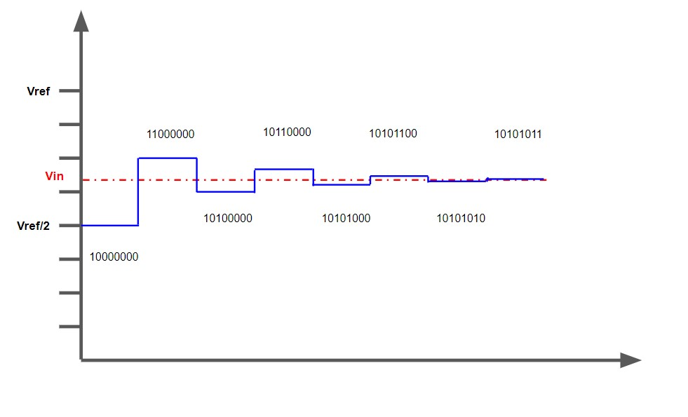
SAR ADC
A type of analog to digital converter - convert continuous analog waveform into a discrete digital representation using binary search through all possible quantization
Fig.Example of expected DAC output

Slide 4
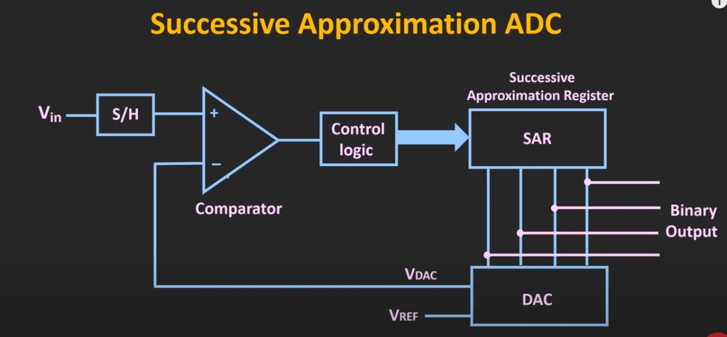
Overall Structure
Digital Output

Slide 5
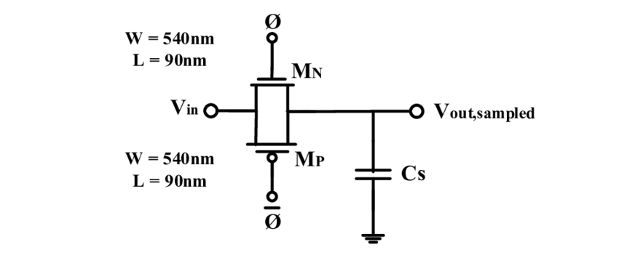
Sample and Hold
Circuit samples an analog signal and stores the result in memory element until the next sampling instant

Slide 6
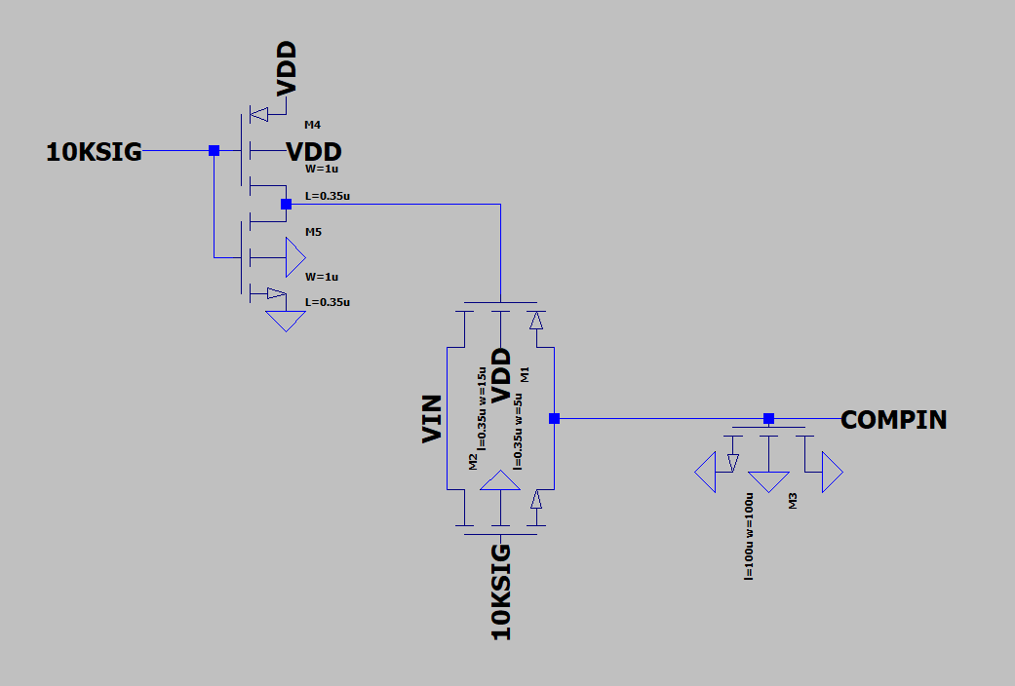
Sample and Hold: Schematic
Inverter for clock bar
Transmission Gate
MOSFET for Capacitance

Slide 7
Sample and Hold: Design Process
Conventional Open-Loop Architecture
Simple
High speed
Excluded Input and Output Buffer
Input signal is stable
Did not see any degradation in simulation

Slide 8
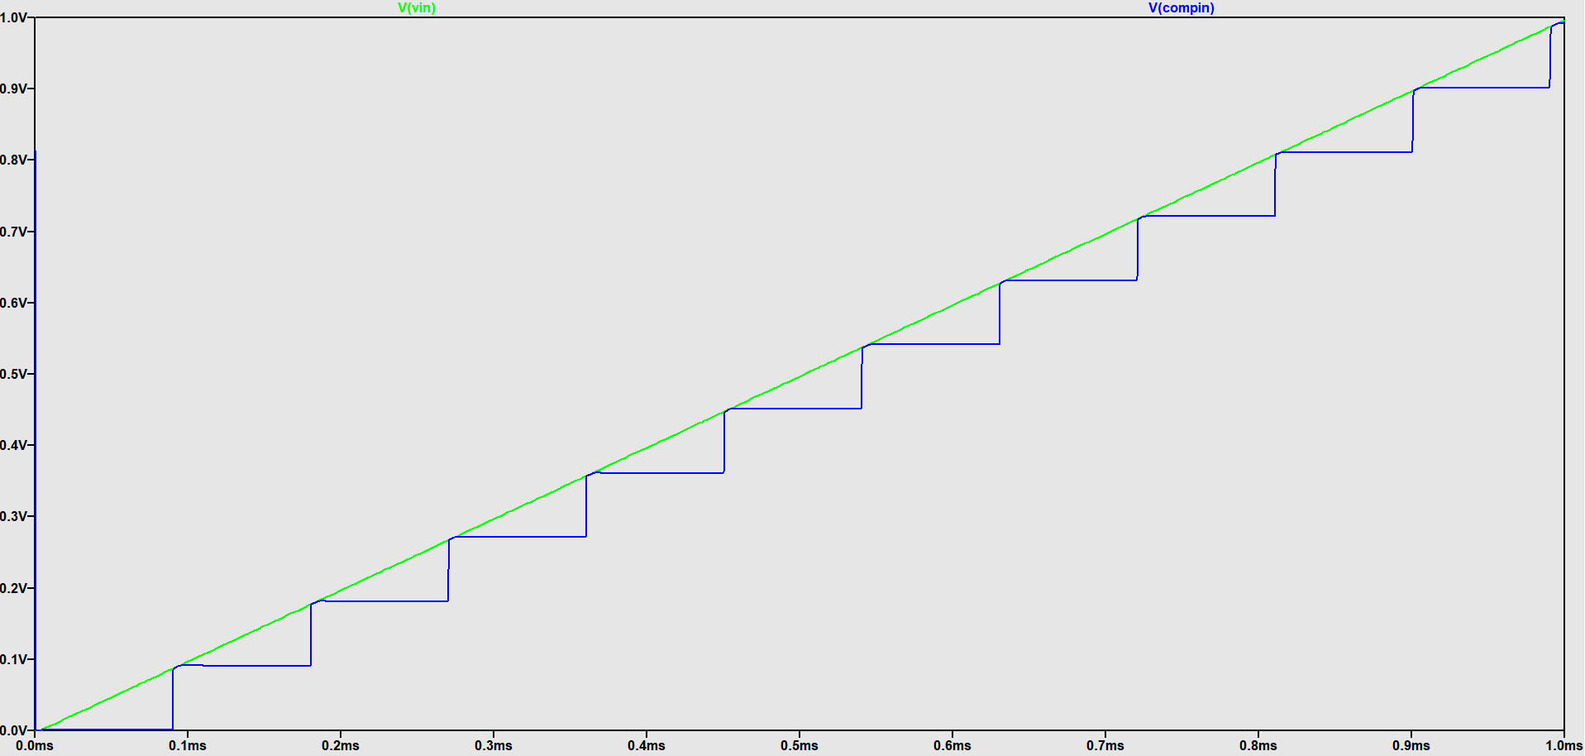
Sample and Hold: Results

Slide 9
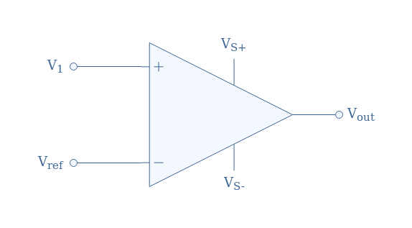
Comparator
Circuit compares two input voltages and outputs either a ‘1’ or a ‘0’ depending on which is larger.

Slide 10
Comparator: Design Considerations
Driven by simplicity
Sensitive
Able to sense and compare voltage differences as low as 0.004 V

Slide 11
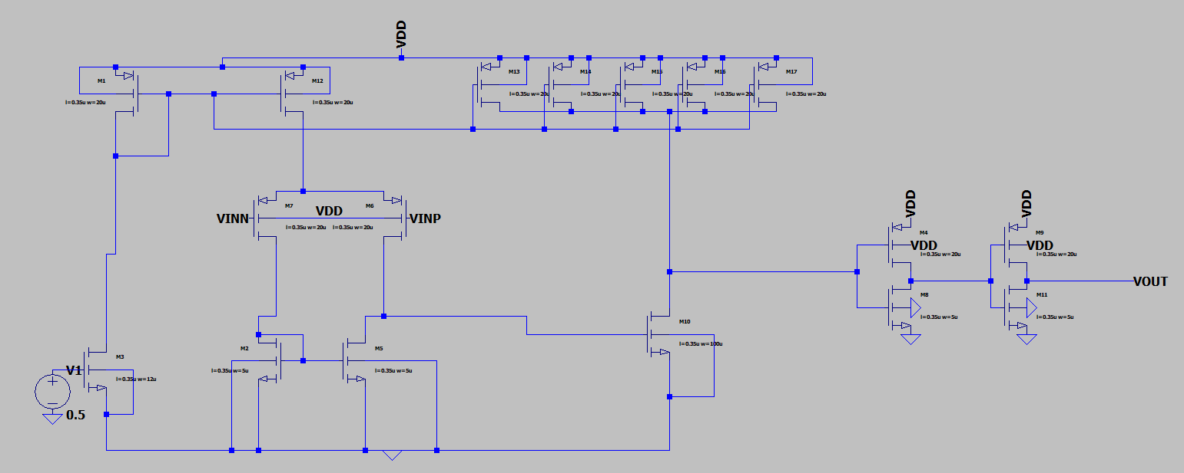
Comparator
Differential Amplifier
Sense Amplifier
Push Pull Output Stage
Buffer

Slide 12
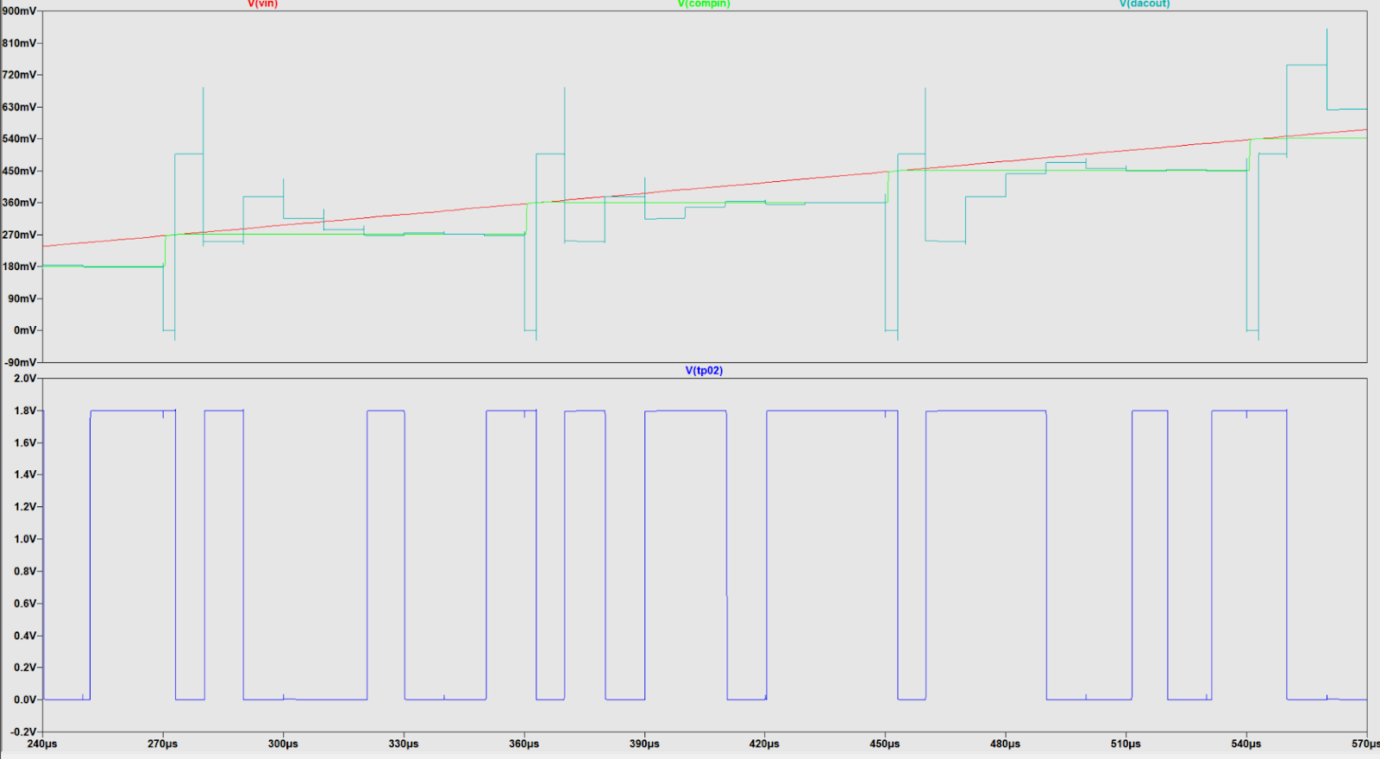
Comparator: Results

Slide 13
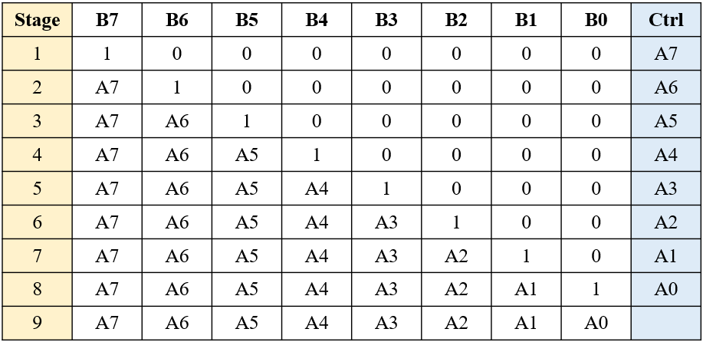
SAR(Successive approximation Register)
By shifting the high signal at the upper shift register, SAR can transfer the signal from control logic to digital output.
The operation table of the SAR in our project.

Slide 14
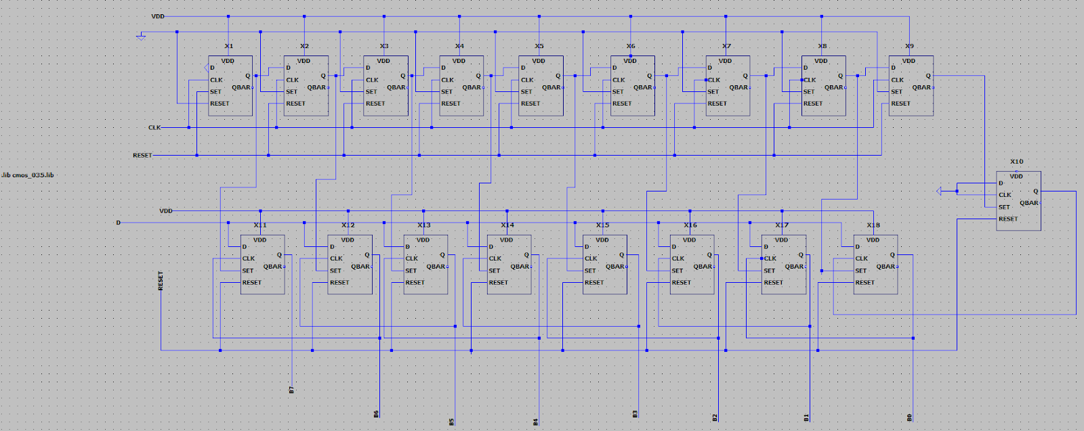
SAR(Successive approximation Register)
Our design of SAR
It consists of some D Latches.

Slide 15
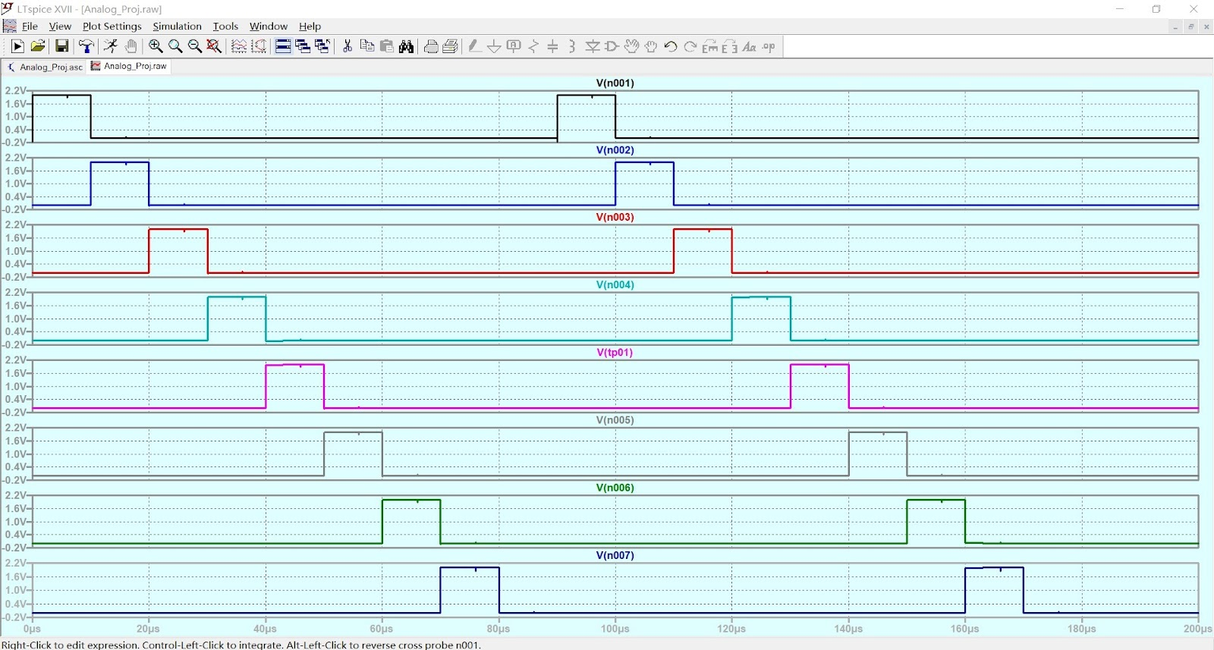
SAR Simulation (Shift Register)

Slide 16
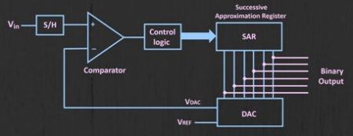
DAC design objection
Convert the SAR digital signal into analog signal.
Pass the analog signal into comparator.

Slide 17
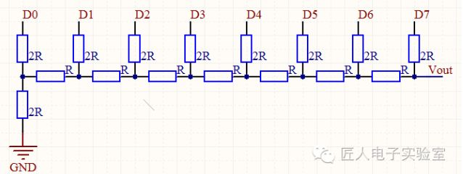
R2R DAC feature
Ladder-like configuration of the resistors
Combination with 2 value resistors
2n resistors for n bit (n-1 R, n+1 2R)
Simple design

Slide 18
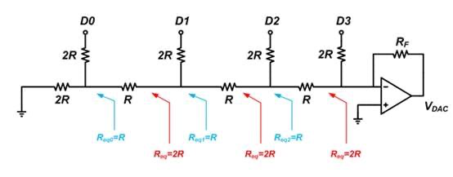
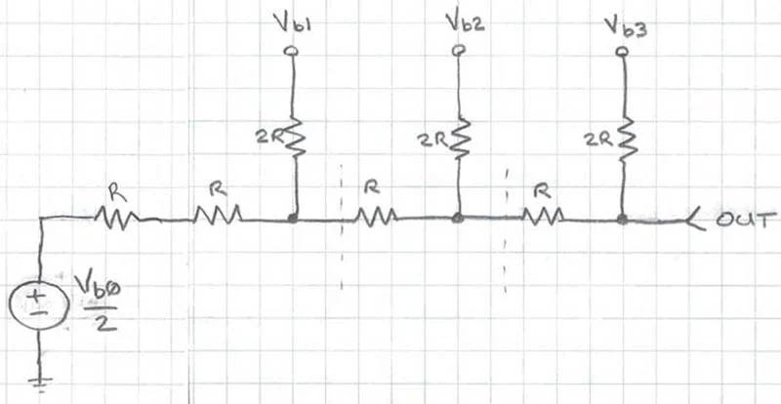
Operation principle
Take “10100000” for example, Vref = 2.0 V
We use Thevenin’s theorem to analyze R2R DAC circuit.
Every stage has the same equivalent resistor value (2R).
Next stage voltage will be half of front stage.
So we can calculate that “10100000” will output 1.25 V
1*1+0*0.5+1*0.25+0*0.125+…=1.25 V
General equivalent resistor
General equivalent voltage source

Slide 19
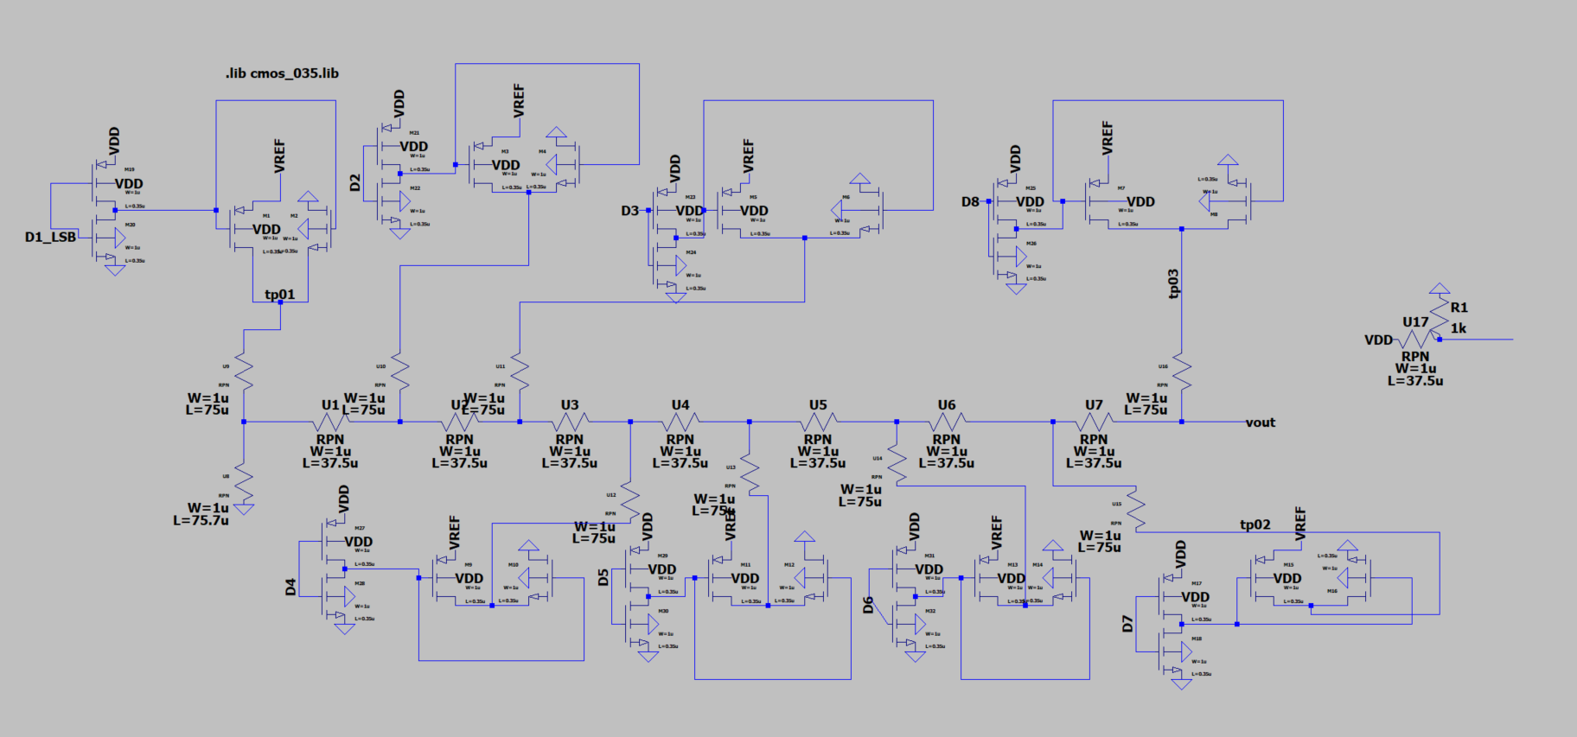
Design schematic
1 INV.+1SW.
for 1 bit
R2R system
Resistor RPN:
Rsheet =1.2 kΩ/square,
Square = L / W
TC=-400 ppm/⁣⁡∘C

Slide 20
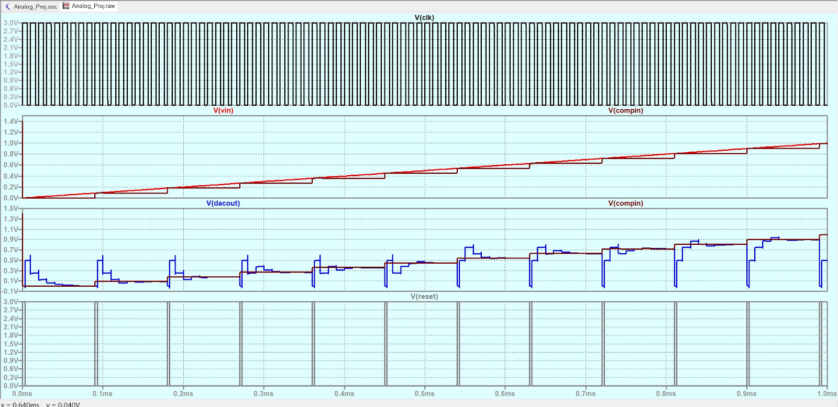
Output Analysis (linear,3V VDD):

Slide 21
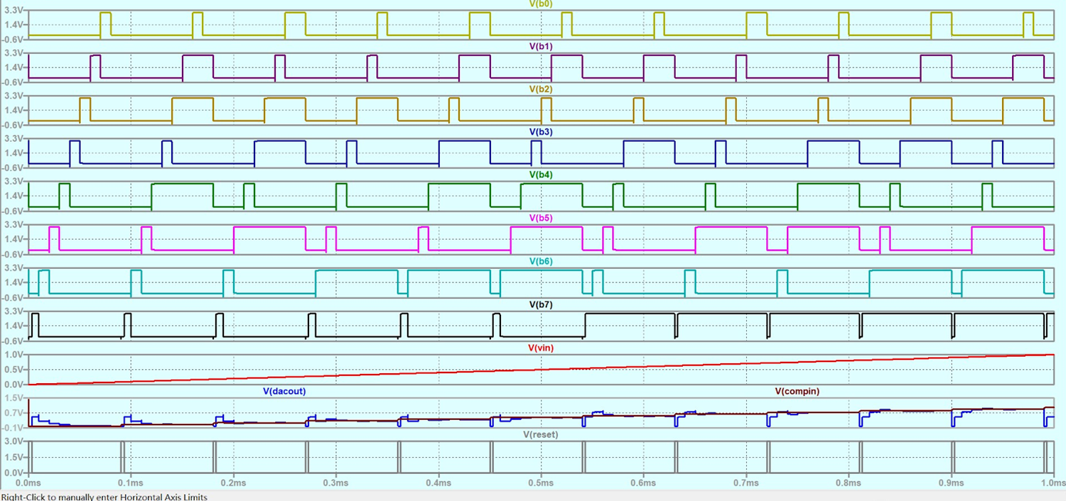
Output Analysis (linear,3V VDD):

Slide 22
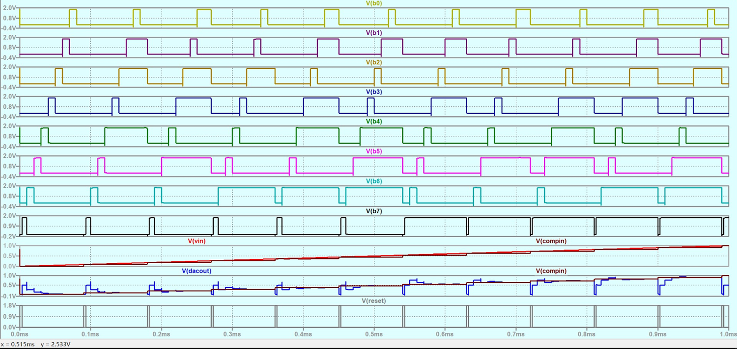
Output Analysis (linear,1.8V VDD):

Slide 23
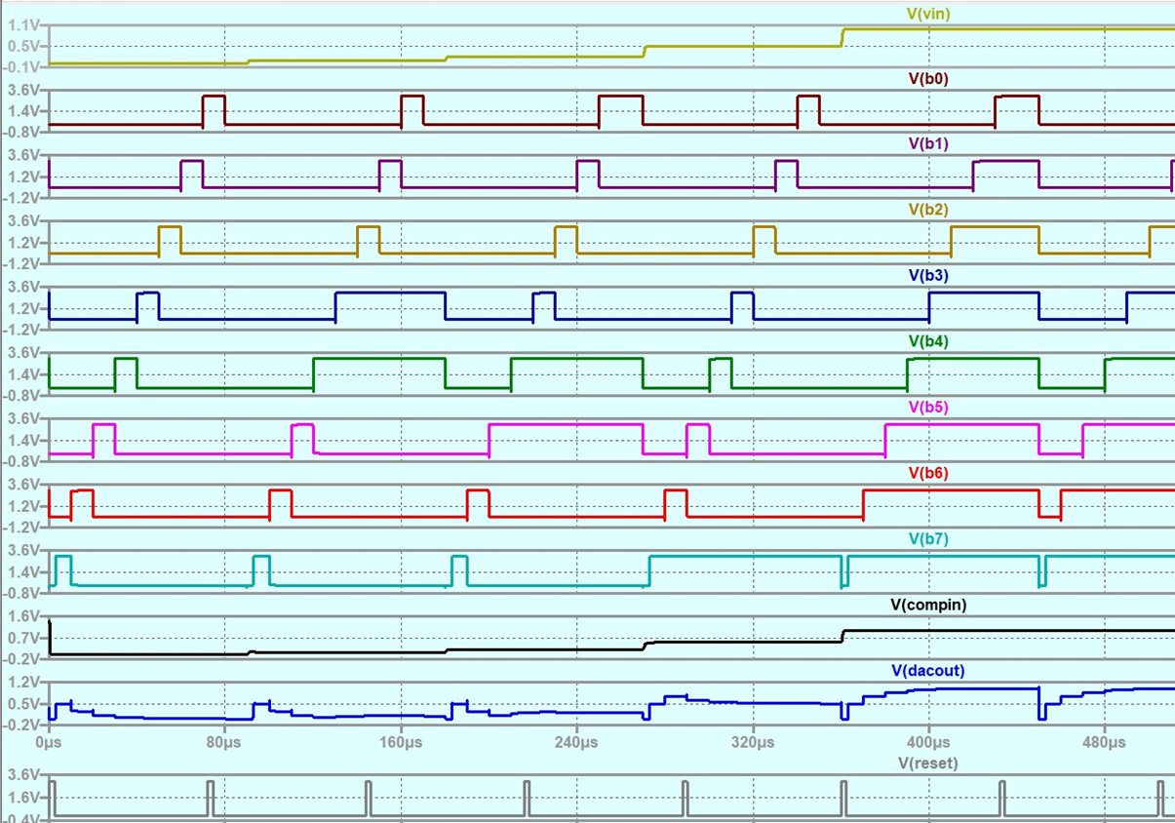
Output Analysis (step,3V):

Slide 24
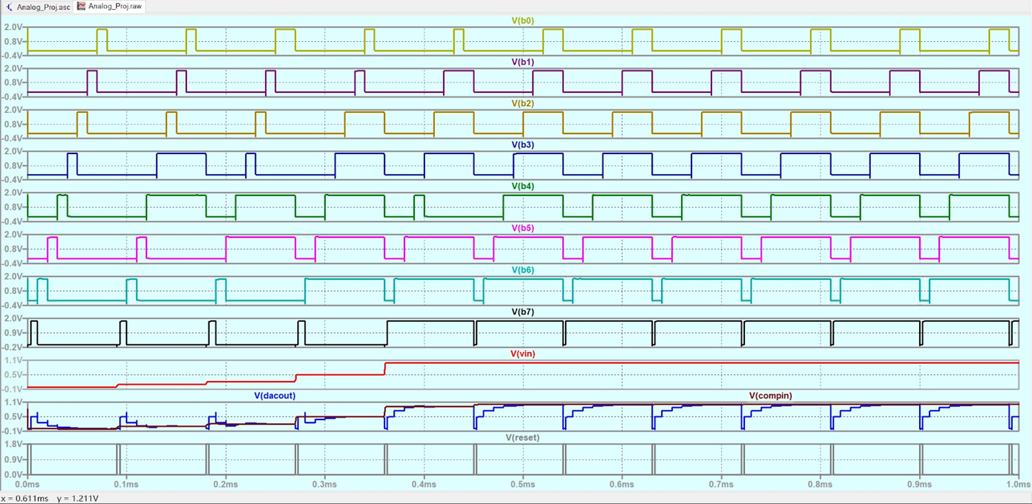
Output Analysis (step,1.8V):

Slide 25
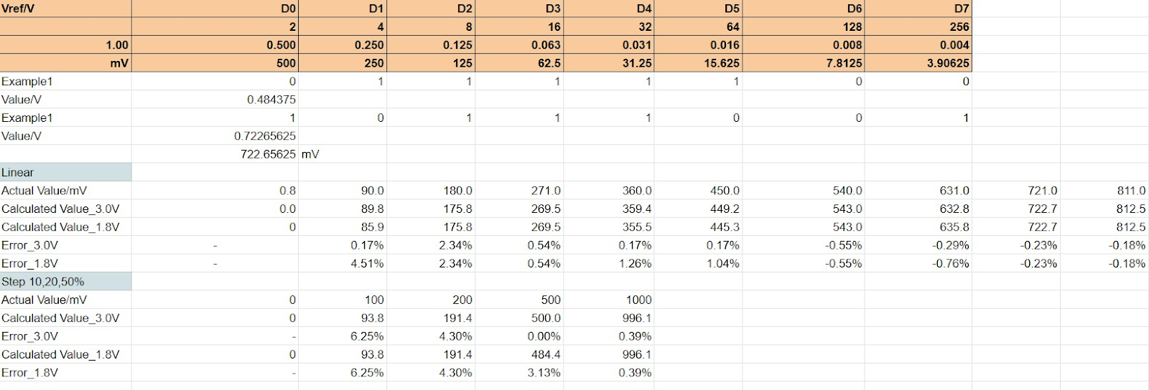
Output Analysis:

Slide 26

8 bit SAR DAC design

Slide 27
Backup Additional Information

Slide 29
Comparator: Design Considerations
Driven by simplicity
Sensitive
Able to sense and compare voltage differences as low as 0.004 V

Slide 30
Comparator
Sense Amplifier
Differential Amplifier
Push Pull Output Stage
Buffer

Slide 31
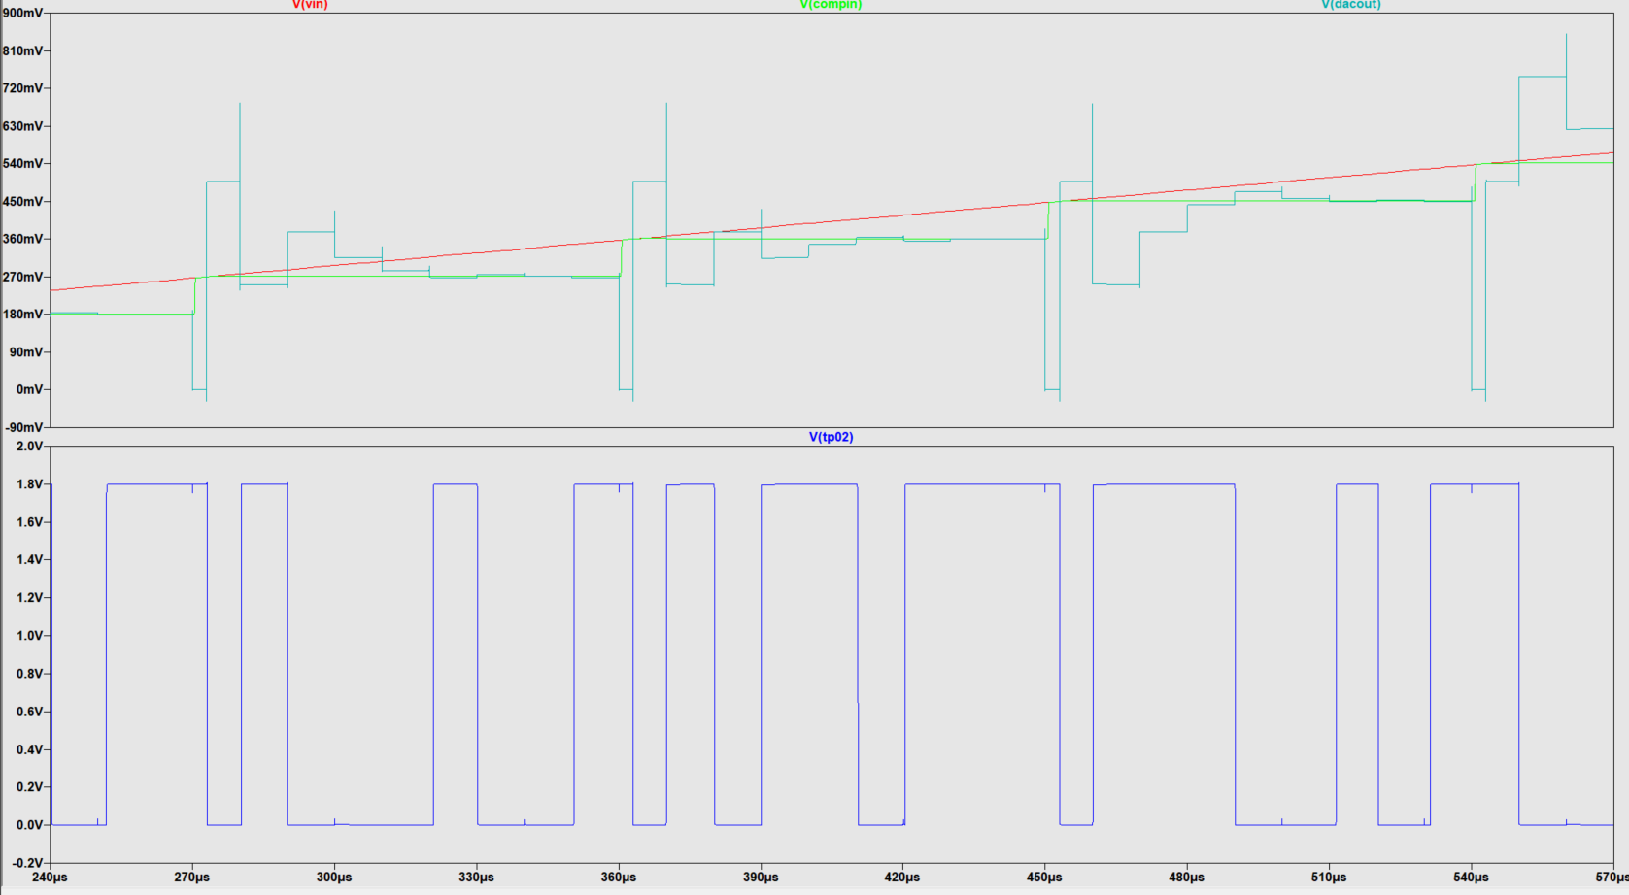
Comparator: Results

Slide 32
SAR(Successive approximation Register)
By shifting the high signal at the upper shift register, SAR can transfer the signal from control logic to digital output.
The operation table of the SAR in our project.

Slide 33
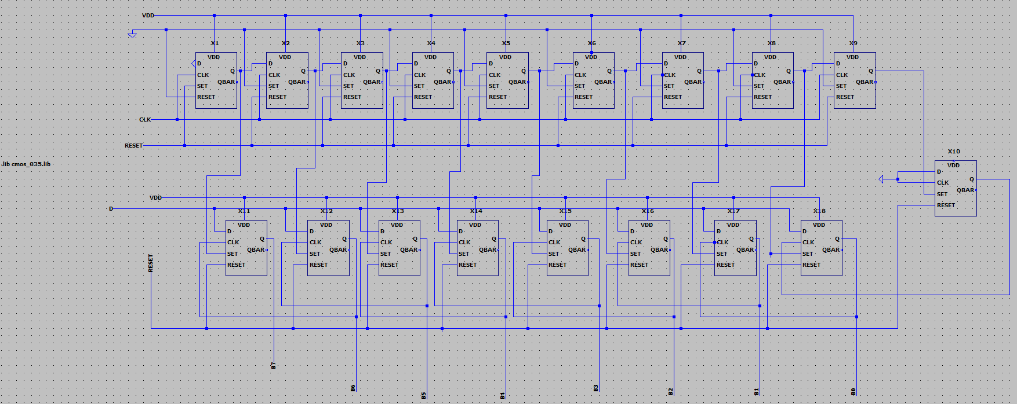
SAR(Successive approximation Register) Schematic
Our design of SAR
It consists of some D Latches.

Slide 34
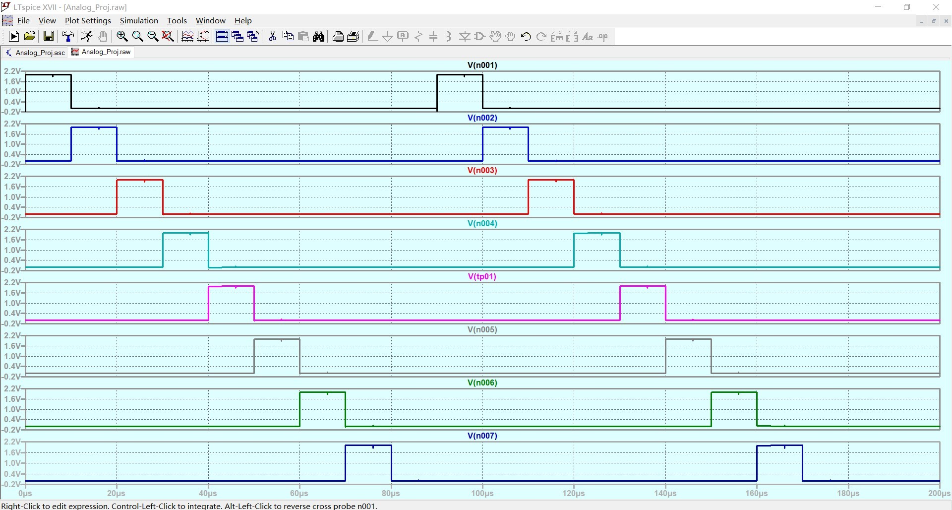
SAR Simulation (Shift Register)

Slide 35
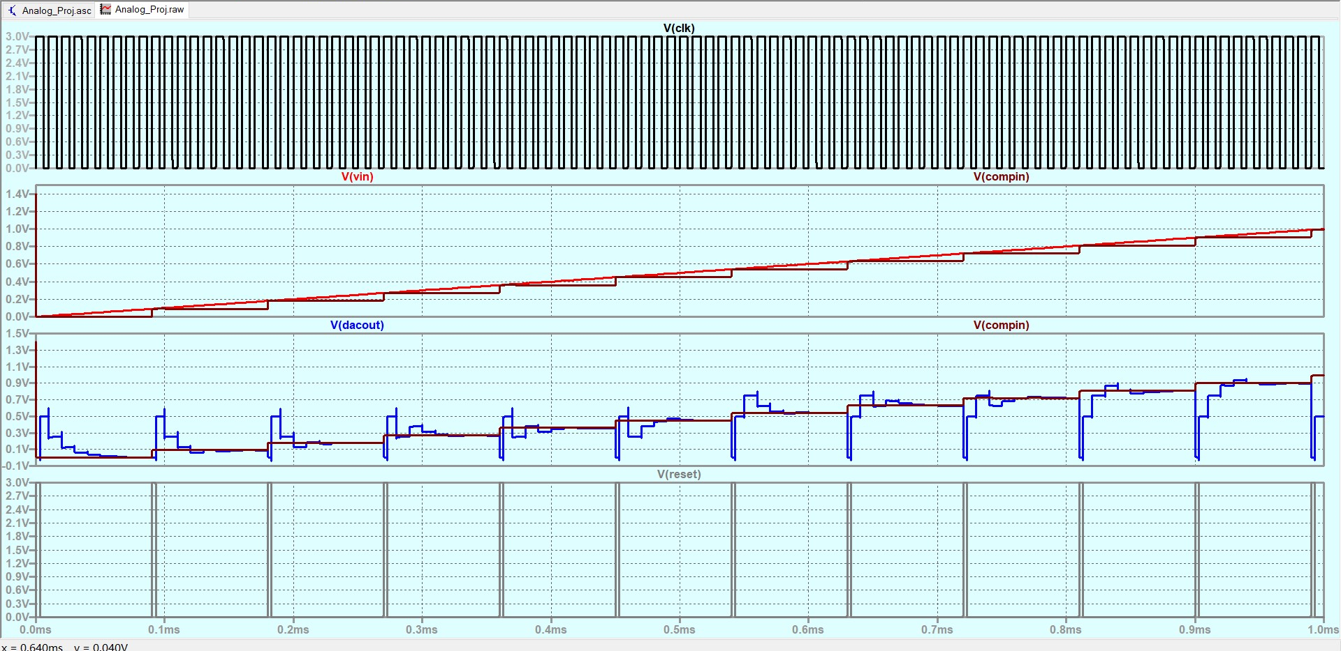
Output Analysis (linear,3V VDD):

Slide 36
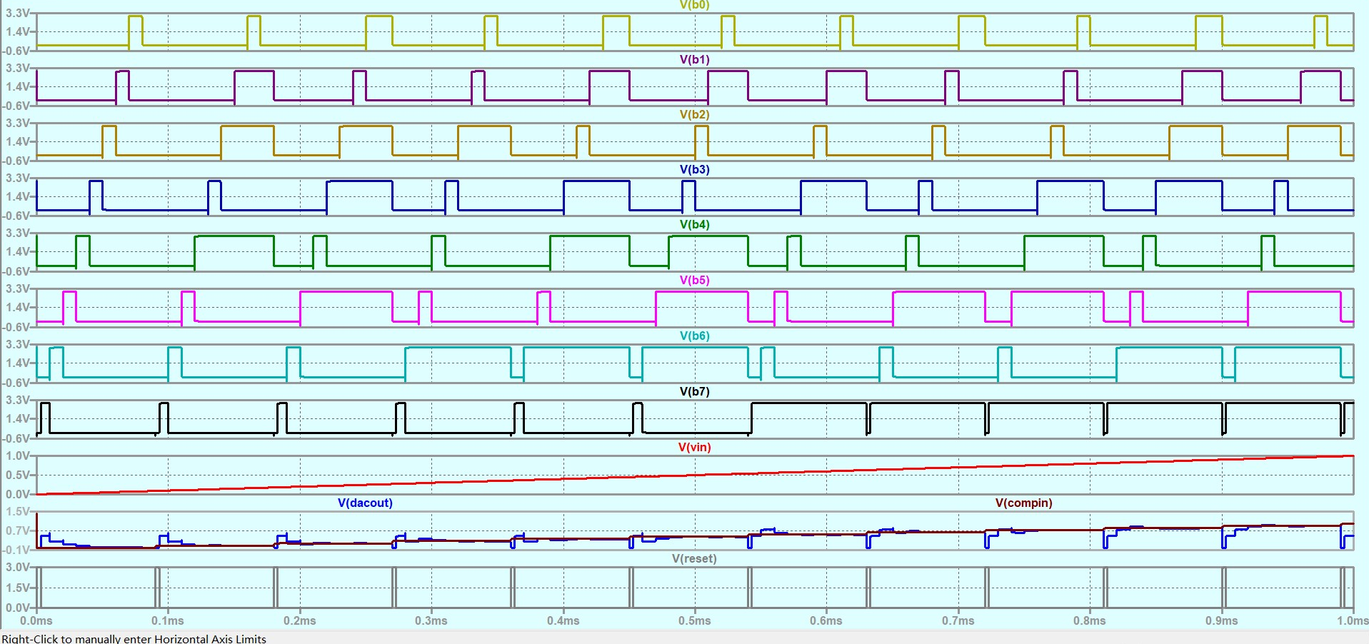
Output Analysis (linear,3V VDD):

Slide 37
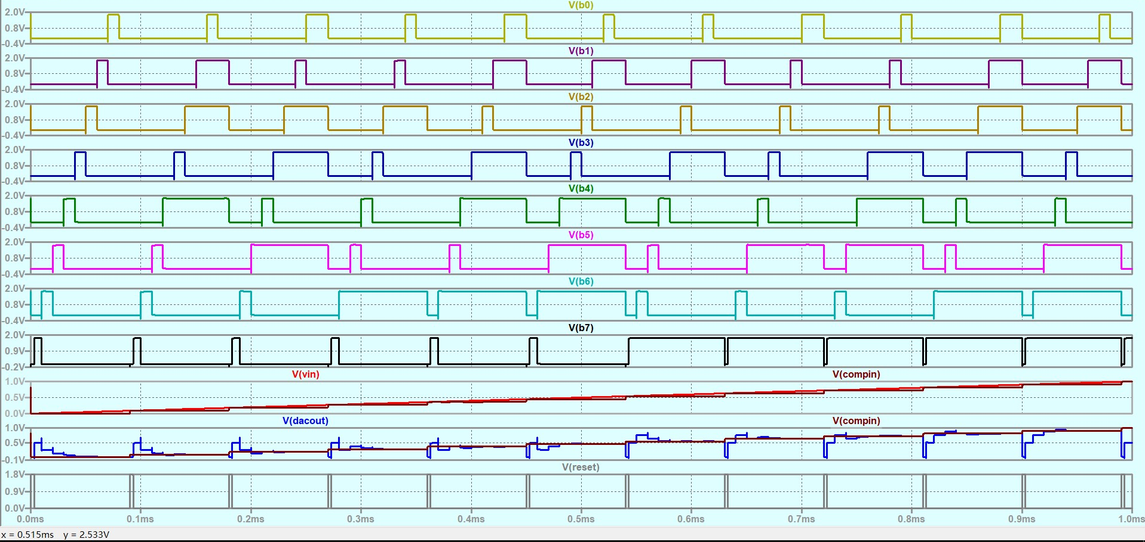
Output Analysis (linear,1.8V VDD):

Slide 38
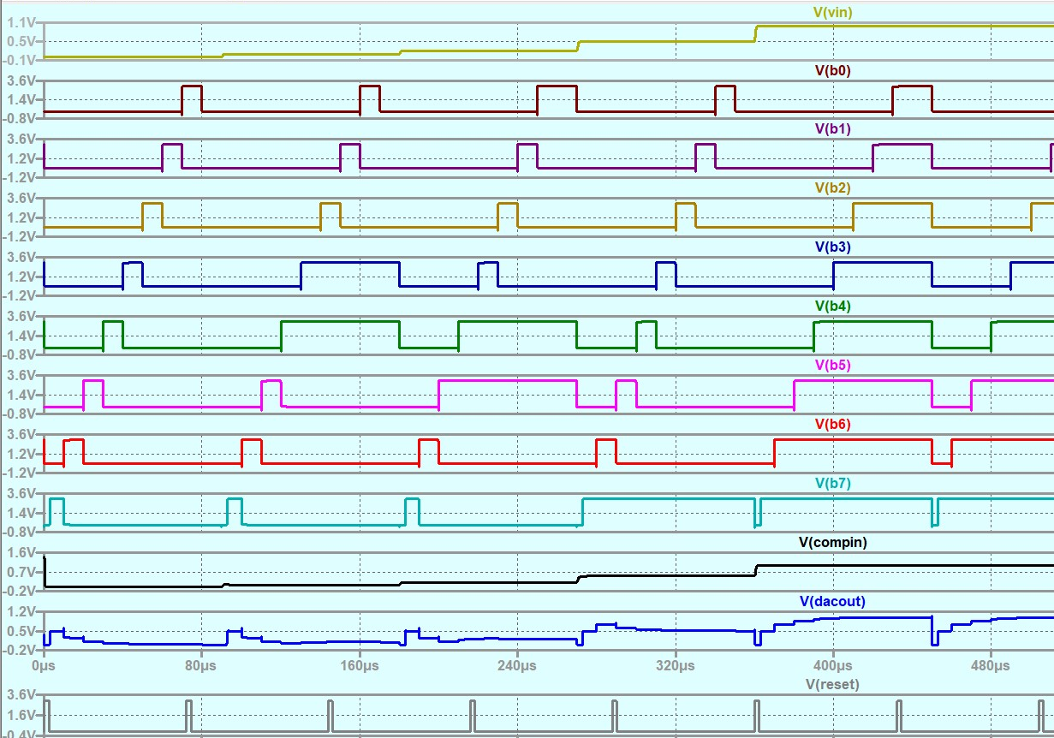
Output Analysis(step,3V):

Slide 39
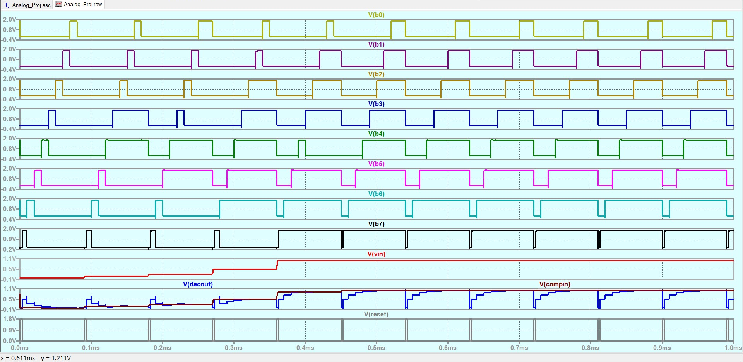
Output Analysis(step,1.8V):

Slide 40

Output Analysis:

Slide 41
Backup / Additional Information

Slide 42
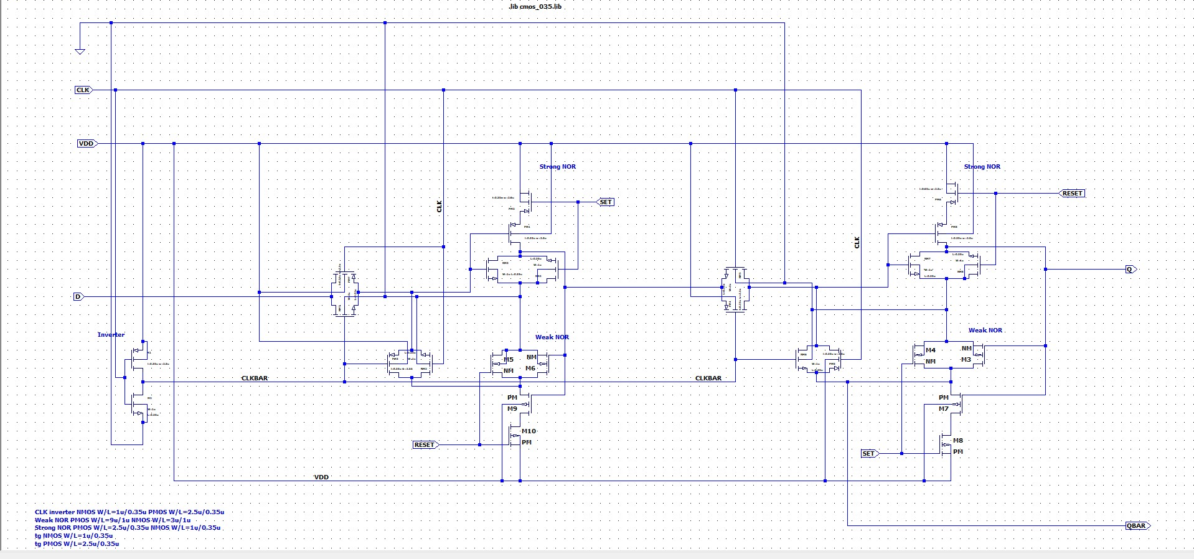
D Latch

Slide 43
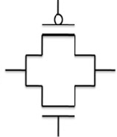
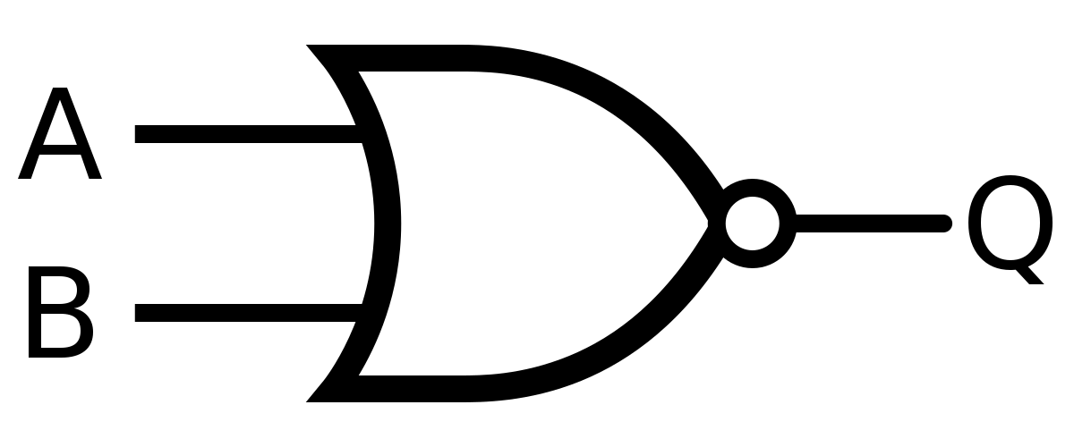
D Latch
SET
RESET
D
CLK’
CLK
SET
RESET
CLK’
CLK

Slide 44
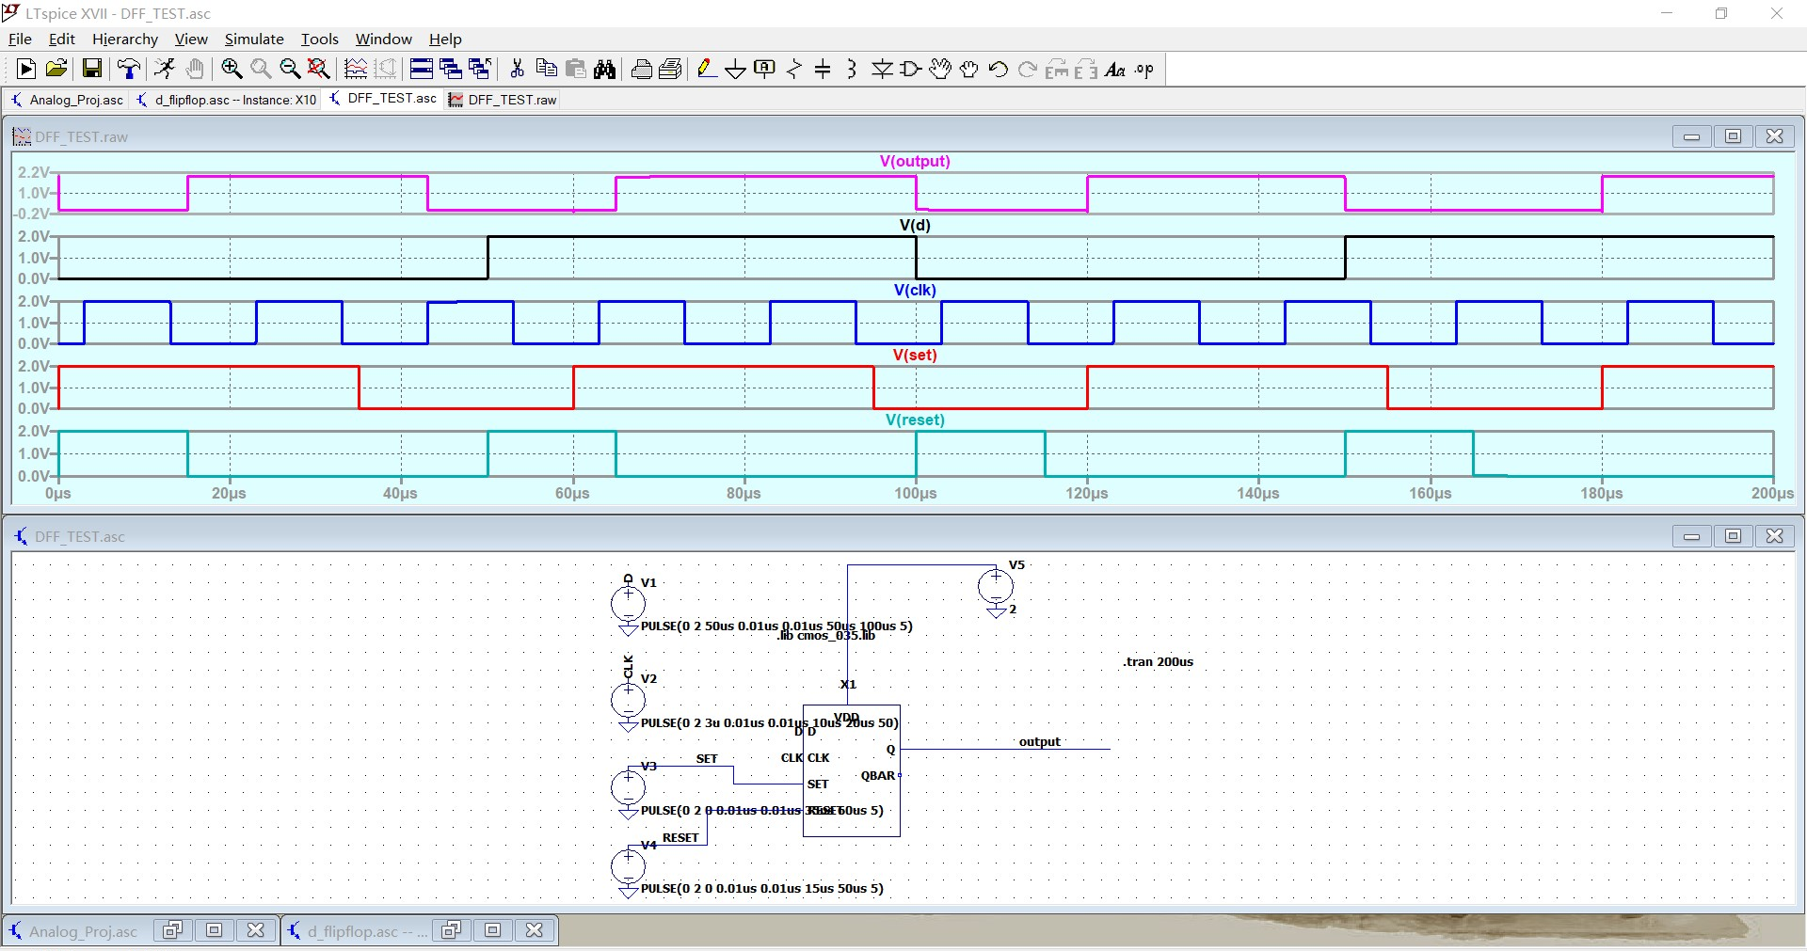
D Latch

Slide 45
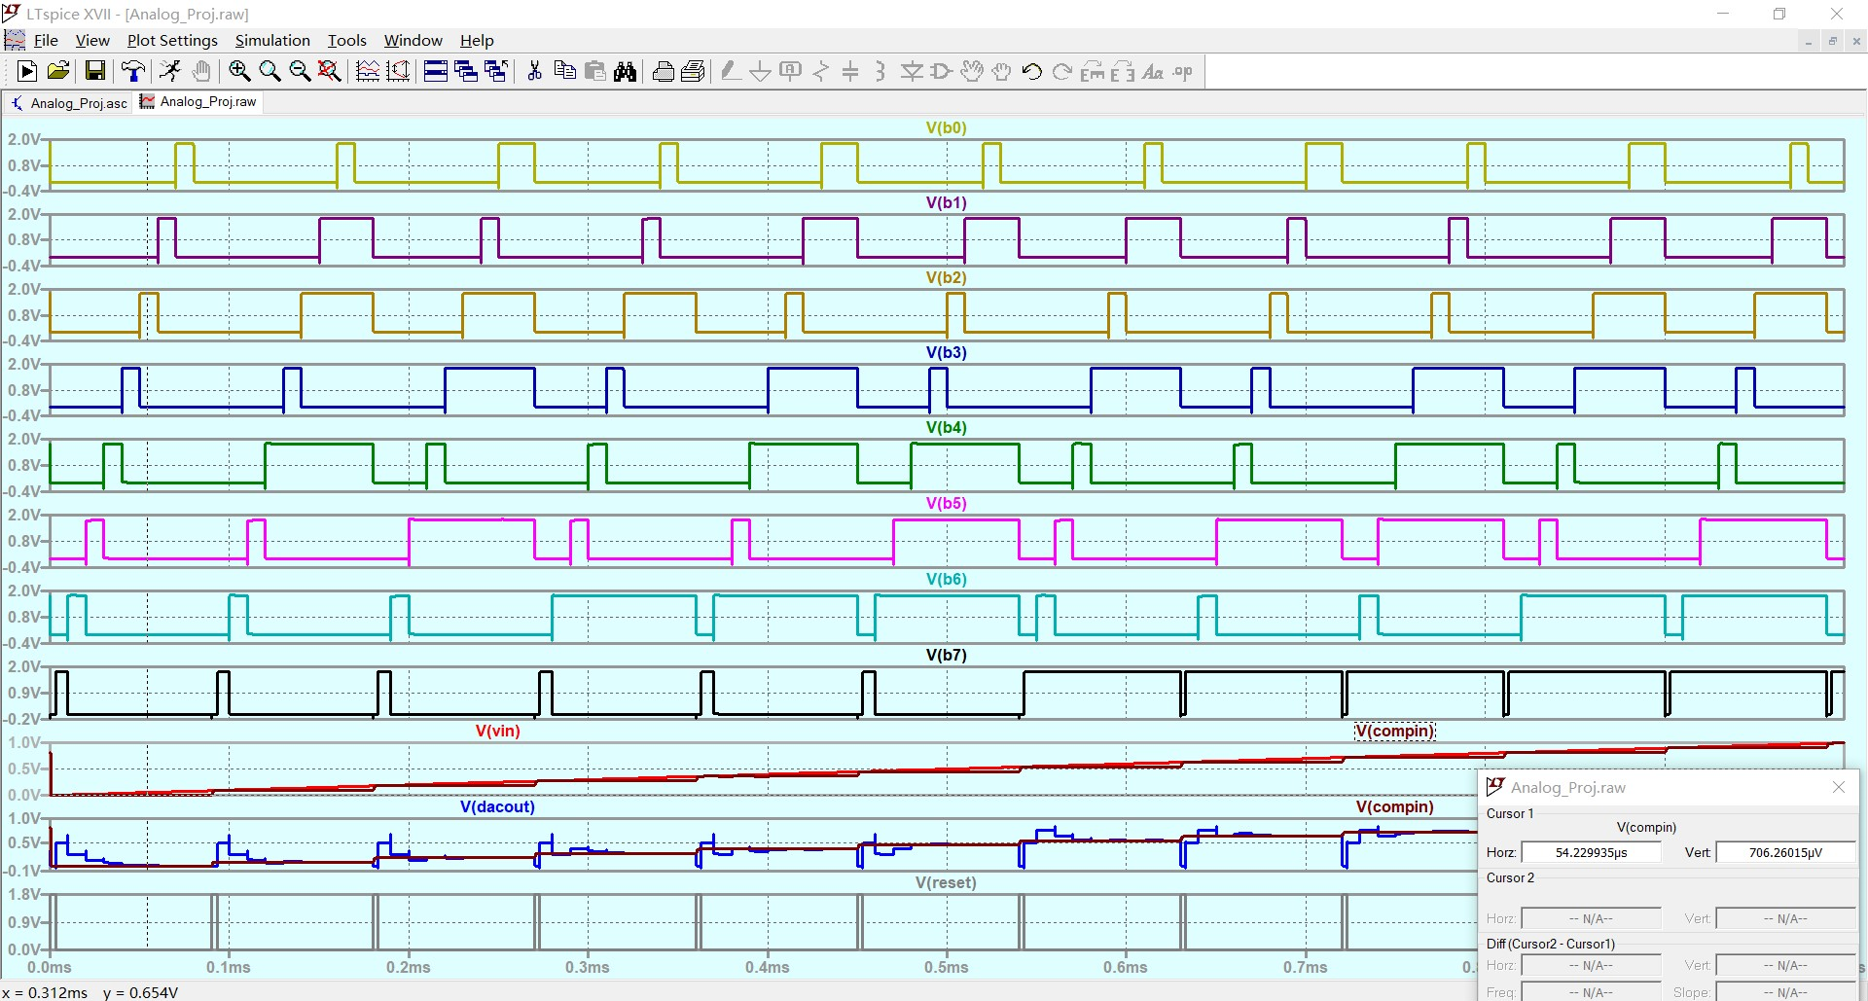
Input (delayed)

Slide 46
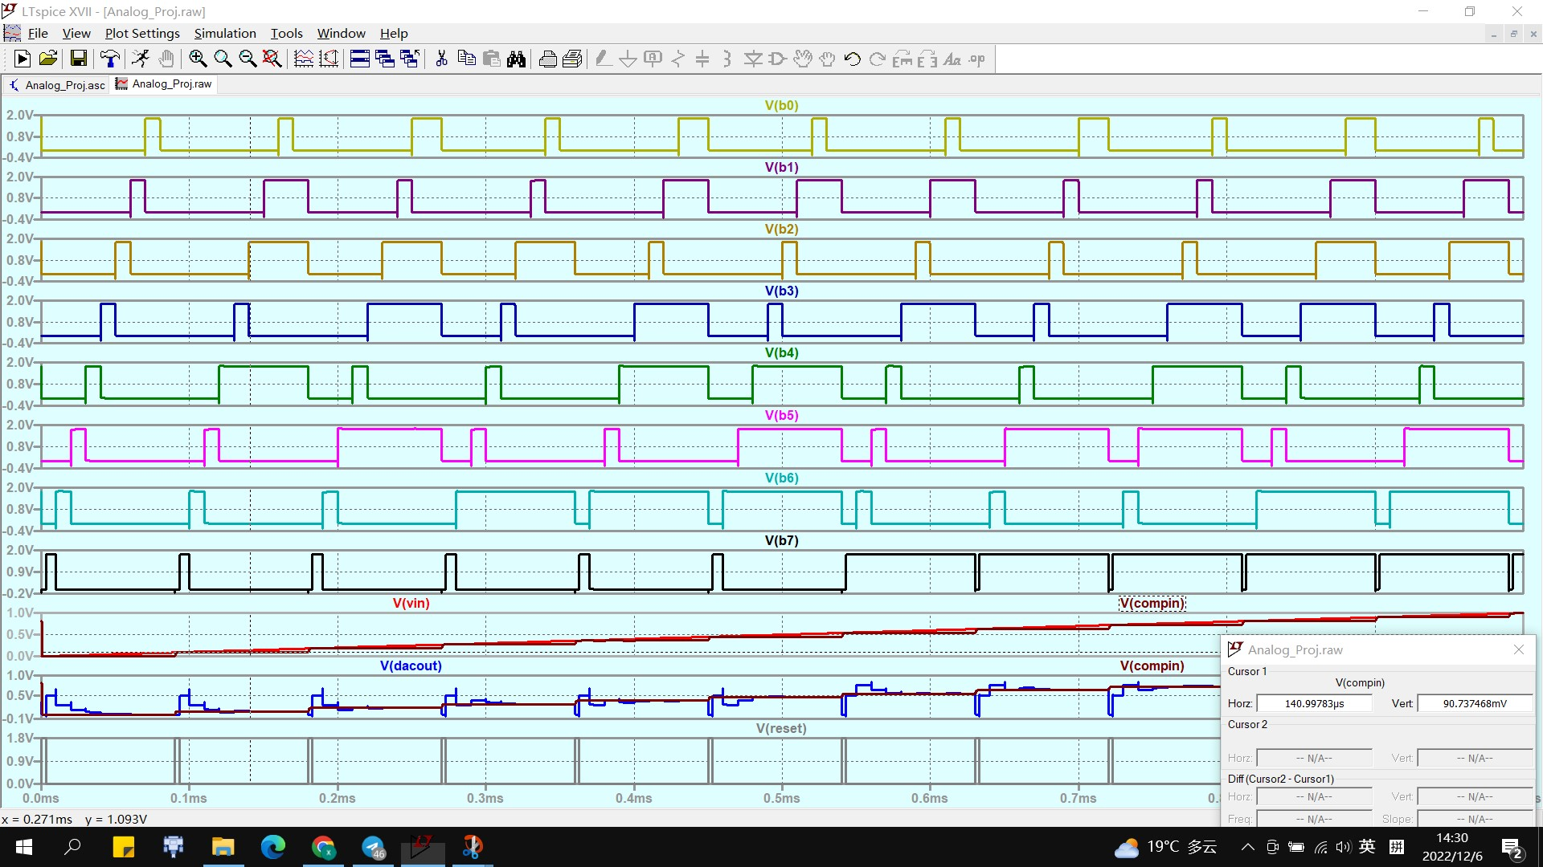
Input (delayed)

Slide 47
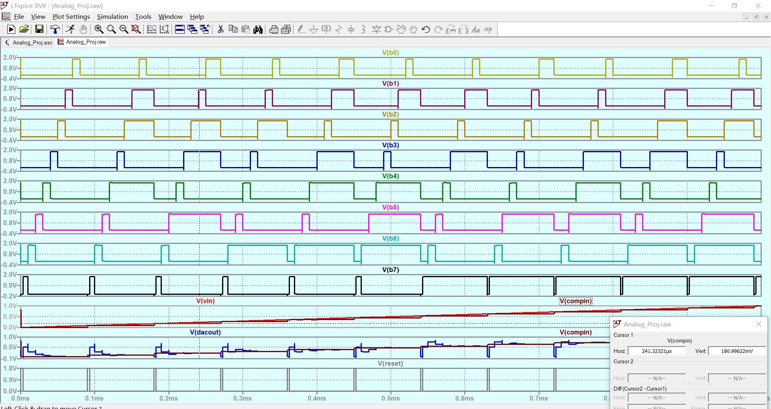
Input (delayed)

